Slide 1
Rapid Mobile App Development with Xamarin.Forms
BRK3282
David Ortinau
Senior Program Manager

Slide 2

You’re not James
David Ortinau
22 years web, interactive, mobile
Advertising, Marketing, Media
Healthcare
@davidortinau
david.ortinau@microsoft.com

Slide 3

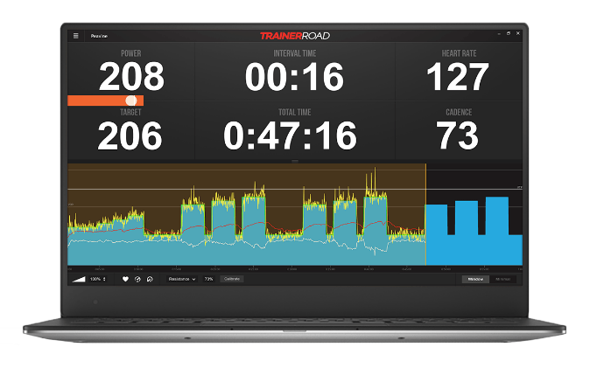
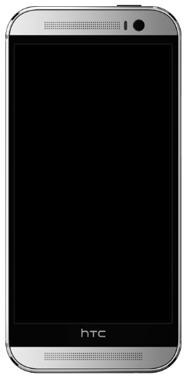
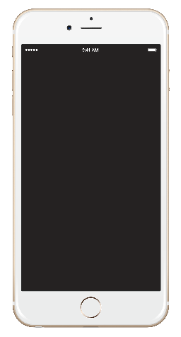
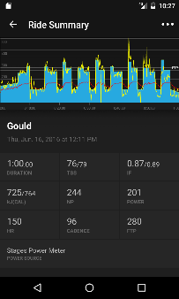
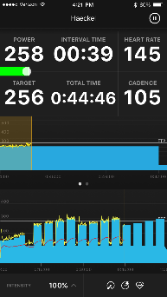
TrainerRoad helps cyclists increase performance with five-star apps
Shares 90% code across Android, iOS, Windows, and Mac
Taps into device-specific capabilities (Bluetooth, etc)
100% native performance and UI
Visual Studio Tools for Xamarin (Xamarin.Forms), Azure, Xamarin Test Cloud, HockeyApp

Slide 4
What is Native?

Slide 5
Native User Interfaces
Native API Access
Native Performance

Slide 6
Architecting Mobile Apps

Slide 7

Silo approach
iOS
Android
Windows
Objective-C/Swift
Xcode
Java
Android Studio
C#
Visual Studio
No shared code • Many languages and development environments • Multiple teams

Slide 8
Write once, run anywhere
Lua
Javascript
Actionscript
HTML+CSS
App generator
Limited native API access • Slow performance • Poor user experience

Slide 9
Xamarin’s unique approach
iOS C# UI
Android C# UI
Windows C# UI
Shared C# logic
Shared C# codebase • 100% native API access • High performance

Slide 10
User Interface

Slide 11

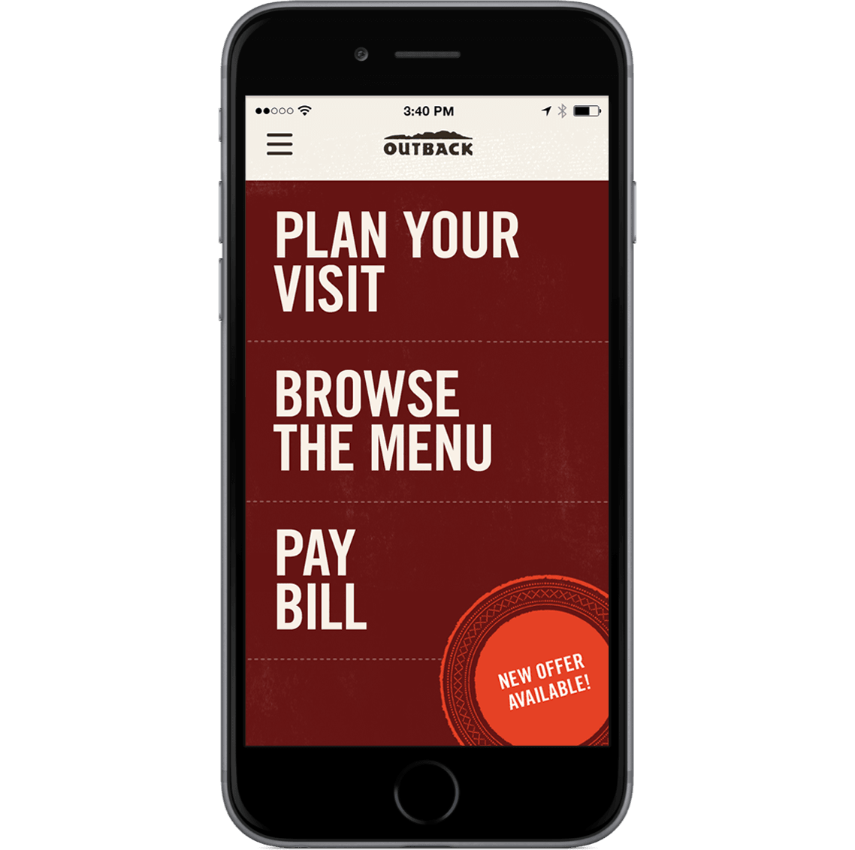

Xamarin Native approach
iOS C#
Android C#
Windows C#
Shared C# Logic
3 Native User Interfaces
Shared App Logic

Slide 12
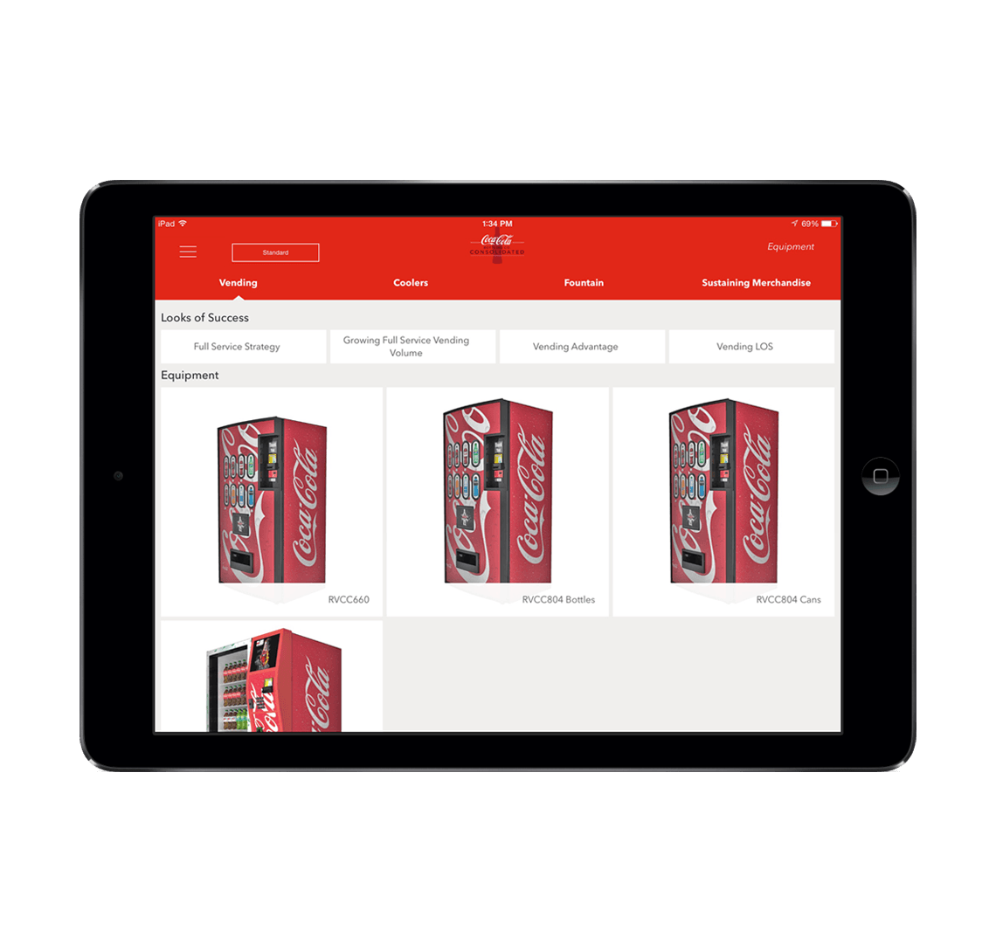
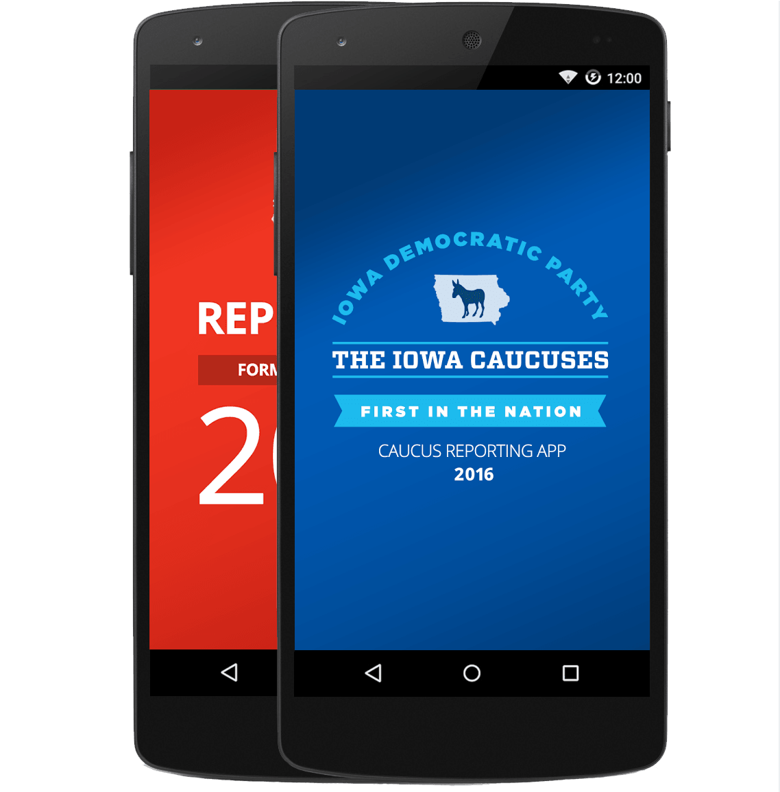
Xamarin.Forms - Cross Platform UI
Shared UI Code
Shared C# Logic
Shared Native User Interface
Shared App Logic

Slide 13

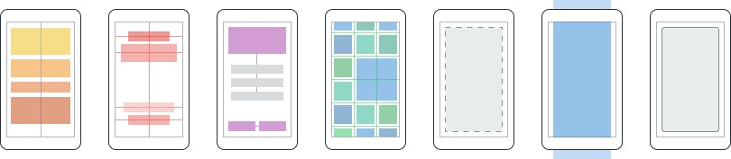
Layouts
Pages
Content
MasterDetail
Navigation
Tabbed
Carousel
Stack
Absolute
Relative
Grid
ContentView
ScrollView
Frame

Slide 14
Controls
ActivityIndicator
BoxView
Button
DatePicker
Editor
Entry
Image
Label
ListView
Map
OpenGLView
Picker
ProgressBar
SearchBar
Slider
Stepper
TableView
TimePicker
WebView
EntryCell
ImageCell
SwitchCell
TextCell
ViewCell

Slide 15
Native UI
Forms elements are realized via platform renderers.
 | ContentPage | Label | Picker
Android | Activity / Fragment | TextView | AlertDialog + LinearLayout + EditText + NumberPicker
iOS | UIViewController | UILabel | UITextField + UIPickerView + UIToolbar + UIBarButtonItem
UWP | Page | TextBlock | ComboBox
developer.xamarin.com/guides/xamarin-forms/application-fundamentals/custom-renderer/renderers/

Slide 16
Bundled Services
DependencyService
MessagingCenter
Navigation
Themes

Slide 17
Your Development Environment

Slide 18
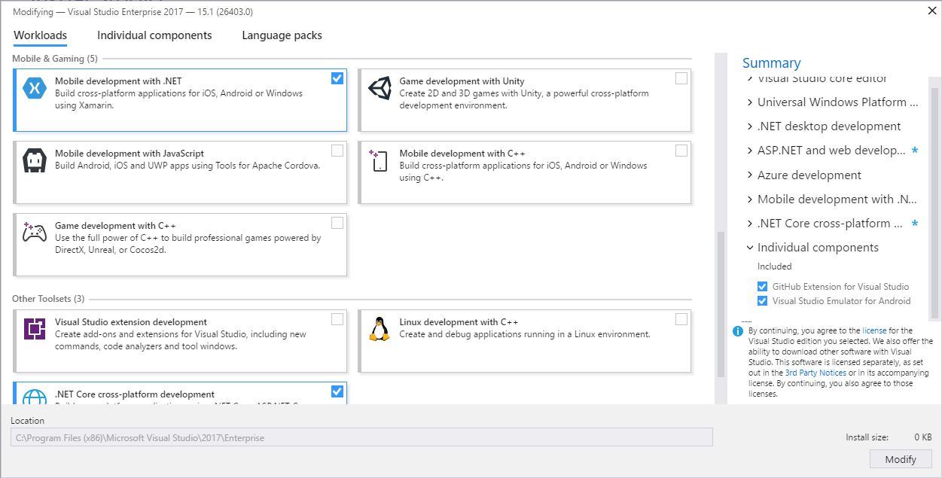
Mobile Workload
Select the Mobile development workload

Slide 19
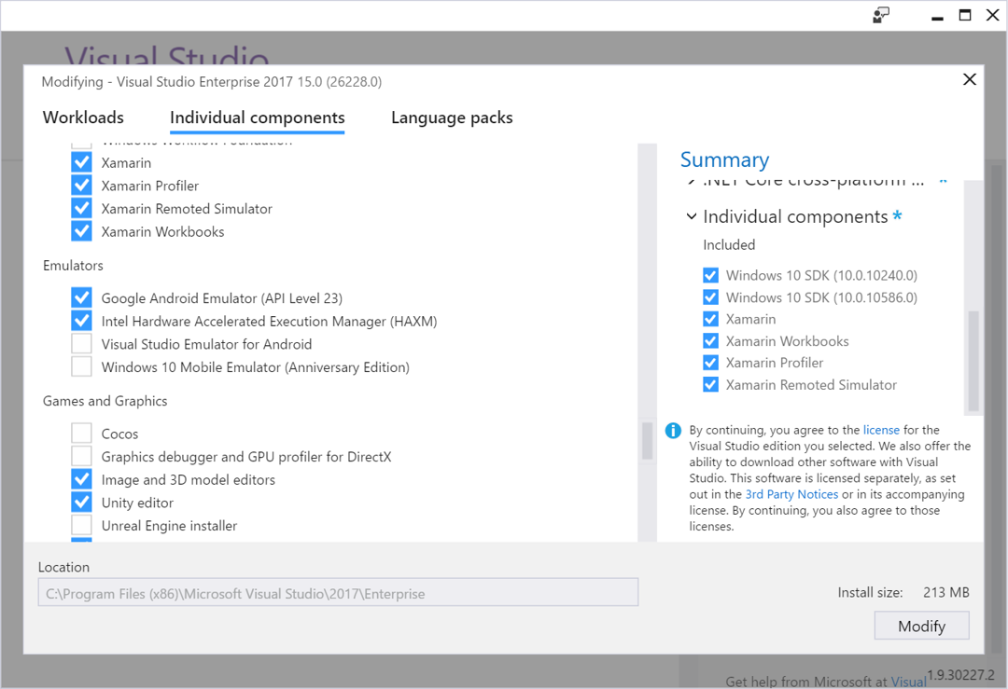
Mobile Emulators
Remoted Simulator (iOS) and Android Emulators

Slide 20
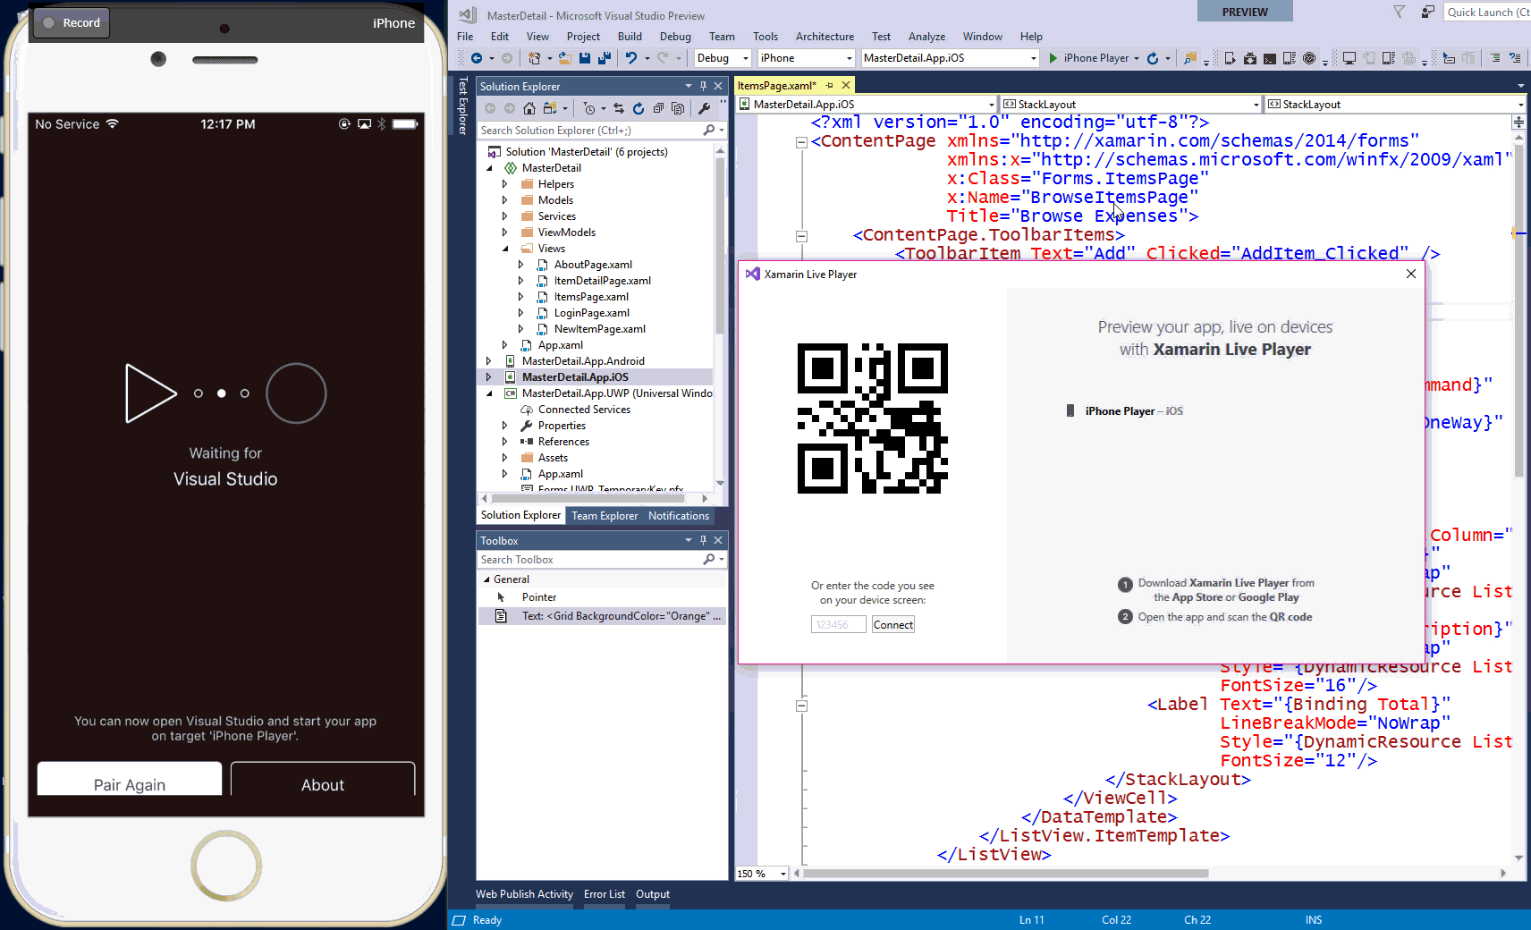

Slide 21
Demo
File > New

Slide 22
Progressive Enhancement

Slide 23
Progressive enhancement
From standard experiences to total control
Forms Element
Platform-Specific
Effect
Custom Renderer

Slide 24
Styling a Forms Element
<Style x:Key="EntryStyle" TargetType="{x:Type Entry}">
<Setter Property="TextColor" Value="{StaticResource WhiteColor}" />
<Setter Property="PlaceholderColor" Value="{StaticResource WhiteColor}" />
<Setter Property="FontSize" Value="{StaticResource LargeSize}" />
<Setter Property="FontFamily" Value="{StaticResource KarlaRegular}" />
<Setter Property="HorizontalOptions" Value="FillAndExpand" />
<Setter Property="FontAttributes" Value="None" />
<Setter Property="Opacity" Value="0.85" />
<Setter Property="effects:LineColorEffect.ApplyLineColor" Value="True" />
<Style.Triggers>
<Trigger TargetType="Entry"
Property="IsFocused"
Value="True">
<Setter Property="Opacity" Value="1" />
</Trigger>
</Style.Triggers>
</Style>

Slide 25
Styling a Forms Element
<Entry
Text="{Binding Email.Value}"
Placeholder="Email">
<Entry.Style>
<OnPlatform
x:TypeArguments="Style"
iOS="{StaticResource EntryStyle}"
Android="{StaticResource EntryStyle}"
WinPhone="{StaticResource UwpEntryStyle}"/>
</Entry.Style>
</Entry>

Slide 26
Platform-Specific
<ContentPage
...
xmlns:ios="clr-namespace:Xamarin.Forms.PlatformConfiguration.iOSSpecific;
assembly=Xamarin.Forms.Core”>
<BoxView x:Name="boxView"
ios:VisualElement.BlurEffect="ExtraLight"
HeightRequest="300"
WidthRequest="300" />
</ContentPage>

Slide 27
Effects - XAML
<Label Text="Label Shadow Effect">
<Label.Effects>
<local:ShadowEffect Radius="5" DistanceX="5" DistanceY="5">
<local:ShadowEffect.Color>
<OnPlatform x:TypeArguments="Color"
iOS="Black"
Android="White"
WinPhone="Red" />
</local:ShadowEffect.Color>
</local:ShadowEffect>
</Label.Effects>
</Label>

Slide 28
Effects - RoutingEffect
public class ShadowEffect : RoutingEffect
{
public float Radius { get; set; }
public Color Color { get; set; }
public float DistanceX { get; set; }
public float DistanceY { get; set; }
public ShadowEffect () : base ("MyCompany.LabelShadowEffect")
{
}
}

Slide 29
Effects - PlatformEffect
[assembly:ResolutionGroupName ("MyCompany")]
[assembly:ExportEffect (typeof(LabelShadowEffect), "LabelShadowEffect")]
namespace EffectsDemo.iOS
{
public class LabelShadowEffect : PlatformEffect
{
protected override void OnAttached ()
{
try {
var effect = (ShadowEffect)Element.Effects.FirstOrDefault (e => e is ShadowEffect);
if (effect != null) {
Control.Layer.CornerRadius = effect.Radius;
Control.Layer.ShadowColor = effect.Color.ToCGColor ();
Control.Layer.ShadowOffset = new CGSize (effect.DistanceX, effect.DistanceY);
Control.Layer.ShadowOpacity = 1.0f;
}
} catch (Exception ex) {
Console.WriteLine ("Cannot set property on attached control. Error: ", ex.Message);
}
}
}
}

Slide 30
Demo
Progressive Enhancement

Slide 31


Xamarin.Forms Ecosystem

Slide 32
Native Control Embedding

Slide 33
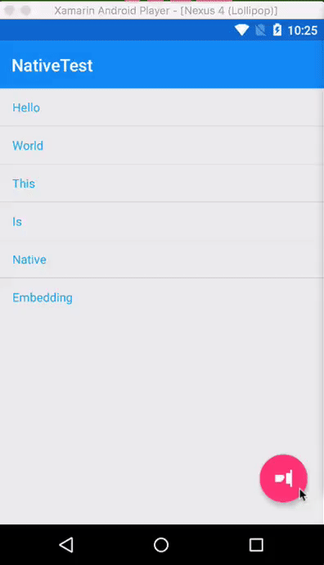
Floating Action Button
An Android-only control that has no Xamarin.Forms abstraction.

Slide 34
#if to target only the desired platform
#if __ANDROID__
using Xamarin.Forms.Platform.Android;
using NativeTest.Droid; //Your Namespace
using Android.Views;
#endif

Slide 35
Add the FAB
#if __ANDROID__
var fab = new CheckableFab(Forms.Context){ UseCompatPadding = true};
fab.SetImageResource(Droid.Resource.Drawable.ic_fancy_fab_icon);
fab.Click += async (sender, e) =>{
await Task.Delay(3000);
await MainPage.DisplayAlert("Native FAB Clicked", "Whoa!", "OK");
};
stack.Children.Add(fab);
absolute.Children.Add(stack); // Overlay the FAB in the bottom-right
... // set layout and add to UI
#endif

Slide 36
Gestures

Slide 37
Gestures
Xamarin.Forms provides easy-to-use gestures.
TapGestureRecognizer
PinchGestureRecognizer
PanGestureRecognizer

Slide 38
TapGestureRecognizer
var tapGestureRecognizer = new TapGestureRecognizer();
GestureRecognizers.Add(tapGestureRecognizer);
tapGestureRecognizer.Tapped += AnimateCardClick;
private async void AnimateCardClick(object sender, EventArgs e)
{
var contentView = (ContentView)sender;
var item = (Grid)contentView.Content;
await item.ScaleTo(0.95, 50, Easing.CubicOut);
await item.ScaleTo(1, 50, Easing.CubicIn);
}

Slide 39
What’s Next for Xamarin.Forms?

Slide 40
2.4.0
.NET Standard 2.0
Stability and Performance
Over 150 fixes
New Feature Flags API
Android Fast Renderers: Button, Image, Label
macOS Preview

Slide 41
vNext
Page Embedding
Layout Compression
Fast Renderers
Right-to-Left
ListView enhancements
Gesture enhancements
FlexLayout
macOS, GTK

Slide 42
Layout Compression

Slide 43
Layout Lifecycle: Invalidation Loop
InvalidateMeasure Called
1
2
Call InvalidateMeasure on Parent
3
Has Parent?
Yes
No
4
Queue Delay Layout

Slide 44
Layout Lifecycle: Layout Loop
InvalidateMeasure Called
1
Layout called
6
2
Call InvalidateMeasure on Parent
7
LayoutChildren Invoked
5
3
Has Parent?
Has Children?
8
Wait for event callback to happen and trigger the layout mechanism
Yes
Yes
No
No
4
Queue Delay Layout
9
Layout Cycle Completed

Slide 45
Forms
Grid
StackLayout
ContentView
Button
Grid
Label
Label
WebView
Button
Image
ScrollView
Image
12
Platform
Panel
Panel
Panel
ButtonRenderer
Panel
LabelRenderer
LabelRenderer
WebViewRenderer
ButtonRenderer
ImageRenderer
ScrollViewRenderer
ImageRenderer
TextBlock
Button
WebView
Label
Button
Image
Image
19

Slide 46
Platform+Compression
12
19
Panel
ButtonRenderer
LabelRenderer
LabelRenderer
WebViewRenderer
ButtonRenderer
ImageRenderer
ScrollViewRenderer
ImageRenderer
TextBlock
Button
WebView
Label
Button
Image
Image
16

Slide 47
Fast Renderers

Slide 48
Forms
Button
Platform
ButtonRenderer
Button

Slide 49
Forms
Grid
StackLayout
ContentView
Button
Grid
Label
Label
WebView
Button
Image
ScrollView
Image
12
Platform+Compression+Fast Renderers
Panel
ButtonRenderer
LabelRenderer
LabelRenderer
WebViewRenderer
ButtonRenderer
ImageRenderer
ScrollViewRenderer
ImageRenderer
WebView
10

Slide 50
Page Embedding

Slide 51
Page Embedding
Xamarin.Forms
iOS C#
Android C#
Windows C#
Shared C# Logic

Slide 52
Demo
Page Embedding

Slide 53
.NET Embedding
Xamarin.Forms
Android Java
iOS
Obj-C
Swift
iOS C#
Android C#
Windows C#
?
Shared C# Logic

Slide 54
XAML Standard
Lots of feedback!
Reconciling the APIs we can without breakage
Considering sharing implementations of
x:Bind
Visual State Manager
More

Slide 55
New Platforms

Slide 56
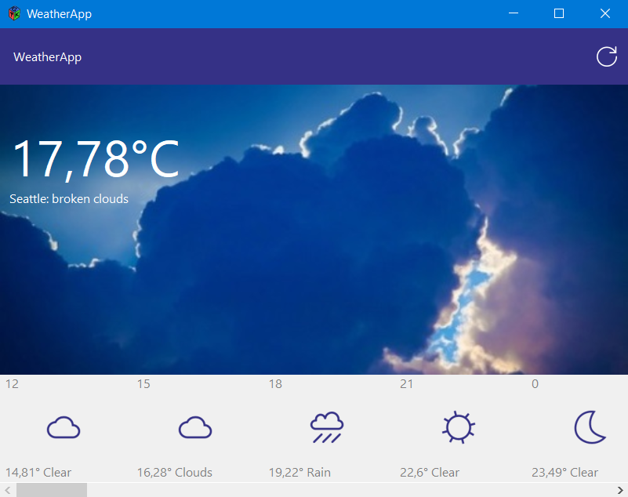

Slide 57

Free self-guided courses
Take free self-guided courses that cover the core Xamarin concepts and count towards certification.
Register at: university.xamarin.com/self-guided
Get a full subscription for live classes, advanced topics, and to complete certification.
Sign up at: xamarin.com/university

Slide 58
Call to action
Get started: xamarin.com/download
Use Xamarin.Forms 2.4.0 today!
Follow the very latest on our Nightly Feed:
github.com/xamarin/Xamarin.Forms/wiki/Nightly-Builds

Slide 59
Please evaluate this session
From your
Please expand notes window at bottom of slide and read. Then Delete this text box.
PC or tablet: visit MyIgnite https://myignite.microsoft.com/evaluations
Phone: download and use the Microsoft Ignite mobile app https://aka.ms/ignite.mobileapp
Your input is important!

